Slide 1
Selenium Course Session 2

Slide 2
Objective
Shortcut Keys
Waits in Selenium
Types of Element Locators

Slide 3
Tricks/Shortcut Keys:
Eclipse
Ctrl + Shift + F - Alignment
Ctrl + Shift + O - Import library
Ctrl + Space bar - Suggestion / Auto Complete
Ctrl + Alt + Down Arrow key - To create a Duplicate the row
Alt + Left Arrow key - To navigate back
Alt + Right Arrow key - To navigate forward
Chrome Browser
Ctrl + Shift + I - Inspect
Ctrl + Shift + C - Select Element Locator
Ctrl + F - Search box

Slide 4
Waits..
Waites in Selenium
Implicitly Wait
Explicit Wait
Driver.manage(). Timeout().
Thread.sleep()
WebDriverWait

Slide 5
Implicitly vs Explicit Waits
Implicit:
Driver.manage().timeouts().implicitlyWait(20, TimeUnit.Seconds);
Explicit:
WebDriverWait wait = new WebDriverWait(driver, 60);
wait.until(ExpectedConditions.visibilityof(driver.findElement(By.name(" "))));
Implicitly | Explicit
Implicit wait time is applied to all the elements in the script | Explicit wait time is applied only to those elements where the user specifies the “ExpectedConditions”
It is recommended to use when the elements are located with the time frame specified in implicit wait | It is recommended to use when verifying the property of the element like (visibilityOfElementLocated, elementToBeClickable, elementToBeSelected)
Executes on remote side (browser side) | Applies on local side

Slide 6
Element Locator
Locator is a command that tells Selenium IDE which GUI elements (Text Box, Buttons, Check Box etc.) its needs to operate on.
Types of Locators:
ID - Attribute
Name - Attribute
ClassName - Attribute
Link Text - Hyperlink
Partial Link Text - Part of the Hyperlink text
CSS Selectors - Style
XPath - XML Language

Slide 7
HTML DOM Nodes
Attribute
Node
Value
Hyperlink
Element Node / Tag Name
Text
Link: http://objectspy.space/

Slide 8
CSS Selector
Features:
Faster way to locate element
Use any attribute to locate element
Use multiple attribute to locate element
Syntax:
TagName#Value Note: (#) represents ID
TagName.Value Note: (.) represents CLASS
TagName[attribute = ‘value’]
TagName.class[attribute = ‘value’]
TagName[href$=‘value’]

Slide 9
XPath..
XPath stands for XML Path Language
It can be used to navigate through elements and attributes in an XML/HTML document
It uses path expressions to select nodes in an XML document

Slide 10
Basic Selecting Nodes
Expression | Description
/ | Selects form the ROOT node
// | Selects nodes in the document from the current node
@ | Selects attributes
* | Matches any element node
@* | Matches any attribute node
Location Path:
2 types of Location Paths
Absolute – starts with a slash (/)
Relative – Starts with a double slash (//)

Slide 11
Xpath Example
Syntax:
//Tag[@Attribute Node=‘Value’]
Example: //input[@id=‘username’]
//Tag[@ Attribute Node =‘Value’ and @ Attribute Node =‘Value’ ]
Example: //input[@type=‘submit’ and @value=‘login’]
Xpath for links/text:
//Tag[text()=‘Value’] or //Tag[contains(text(), ‘Value’)]
Example: //input[text()=‘new page’] or //input[contains(text(), ‘new page’)]

Slide 12
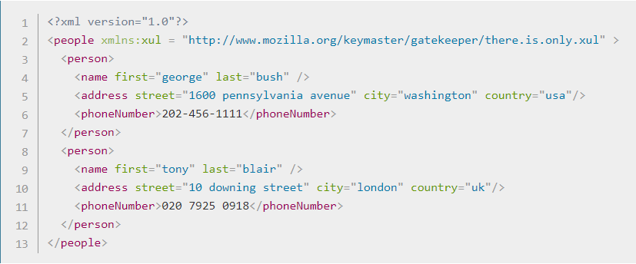
Xpath Axes..
Relationship of Nodes:
Parent
Children
Siblings
Ancestors
Descendants

Slide 13
Homework
Automate the following test case:
Scenario: Users will be able to add Account
1: Open Browser and go to site http://www.techfios.com/billing/?ng=admin/
2. Enter username: demo@techfios.com
3. Enter password: abc123
4. Click login button
5. Click on Bank & Cash button
6. Click on New Account button
7. Fill out the Add New Account form
8. Click on submit button
9. Visually check if the account has been created
Visually check to make sure the deposit posted

Slide 14
Interview Questions
Name some of Element Locators
Difference between Implicitly Wait and Explicit Wait
What is the difference between absolute xpath and relative xpath?
Which XPath do you use?
Which element locator is faster to identify?
If the element is a link, which locator should you use?
Explain the difference between driver.close vs driver.quit
What JUnit annotation is used to run a test?
What Selenium method is used to type something in a text box?

